Slide 1
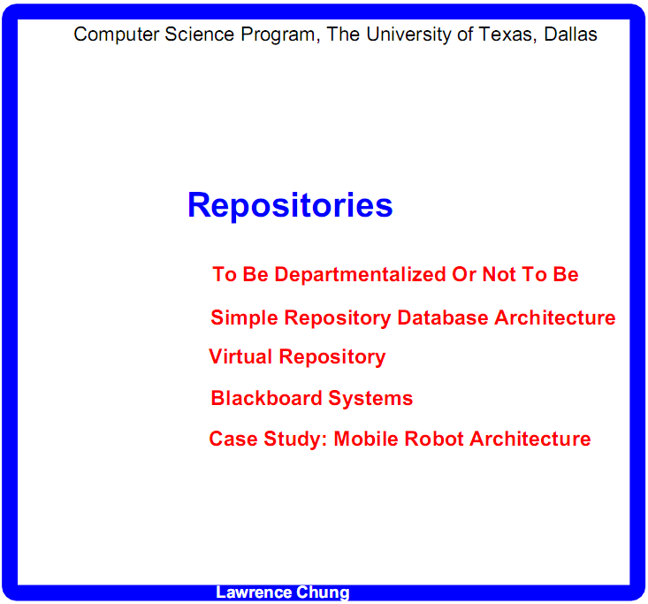

Slide 2
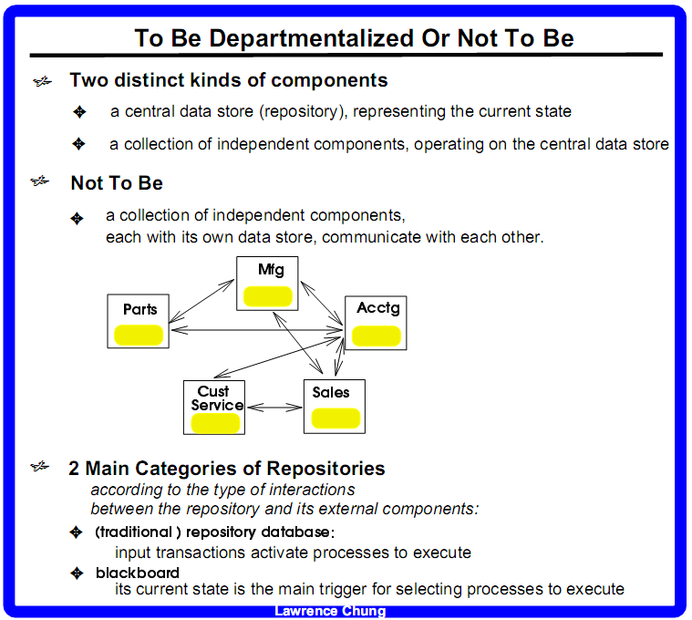
Prog X
bool b1
bool b2
…
bool 100
S1 = {(b1, F), (b2, F), …, (b100, F)}
S2 = {(b1, F), (b2, T), …., (b100, F)}
- latency, timing delay
- data inconsistency
“Do not automate; obliterate”

Slide 3
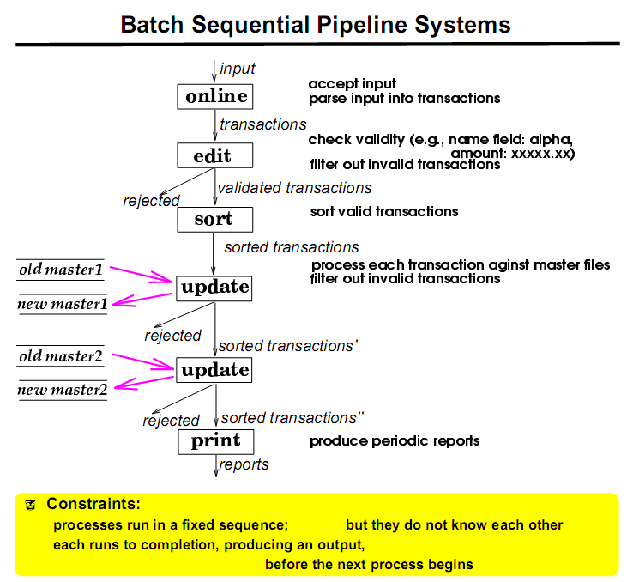

Slide 4
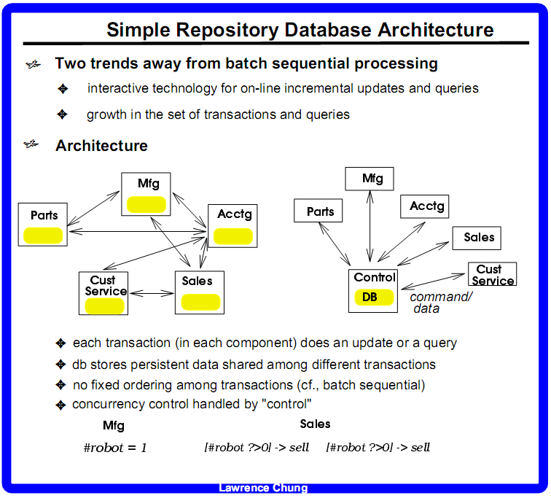
#-seats-left =1

Slide 5
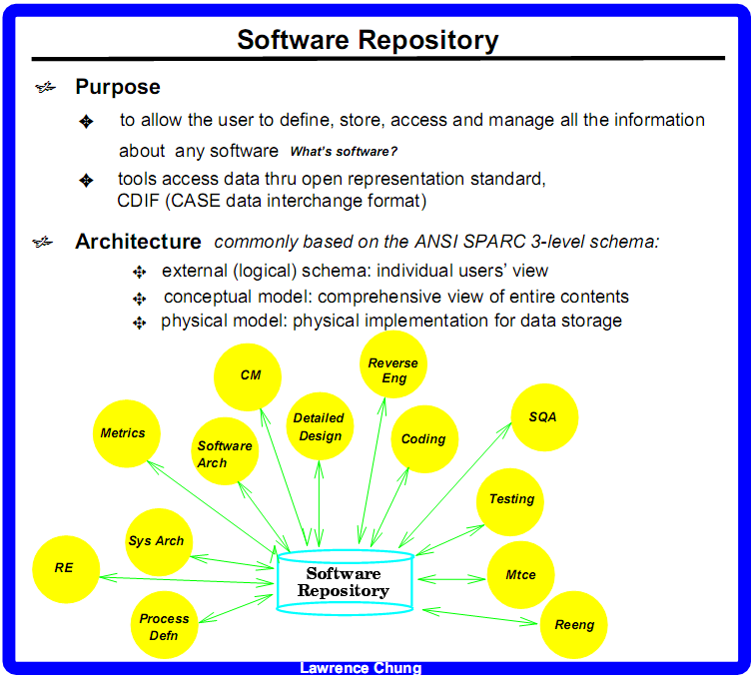
ebcdic

Slide 6
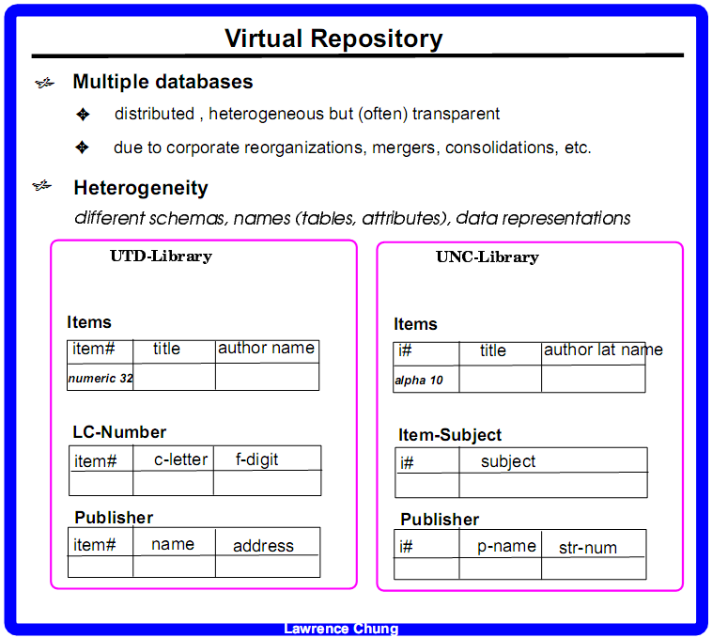

Slide 7
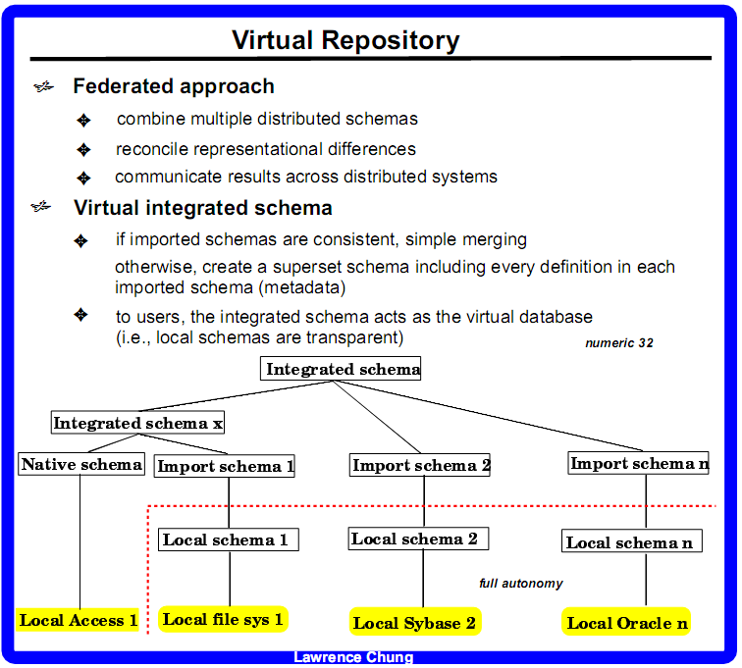

Slide 8
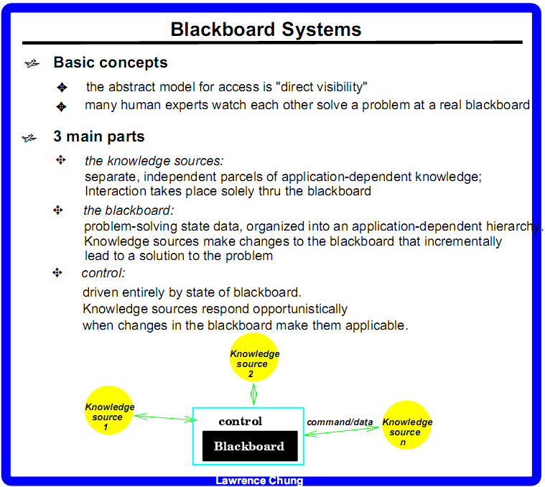

Slide 9
What is rationale in Sw. Arch?
S0:
reasons for selecting a particular arch - James
why a particular arch was chosen - David
Arch. Style - Yeremy
The pros or cons of that specific arch style? - Rick
You looking for the tradeoff analysis? - James
NFRs - James
s1
s2
blackboard

Slide 10
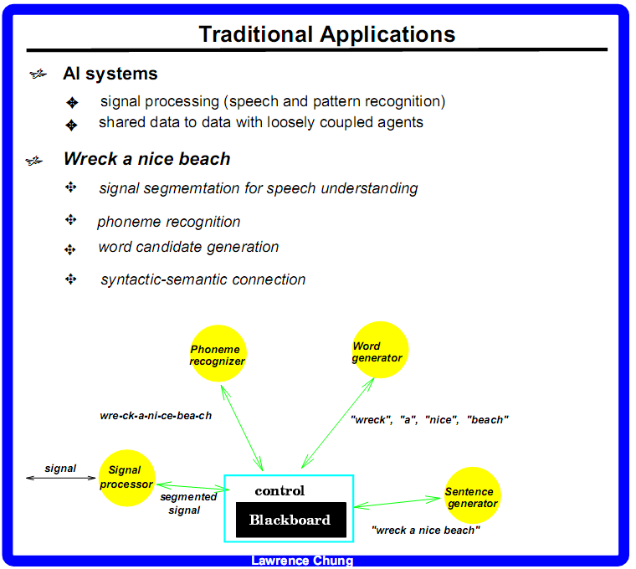

Slide 11
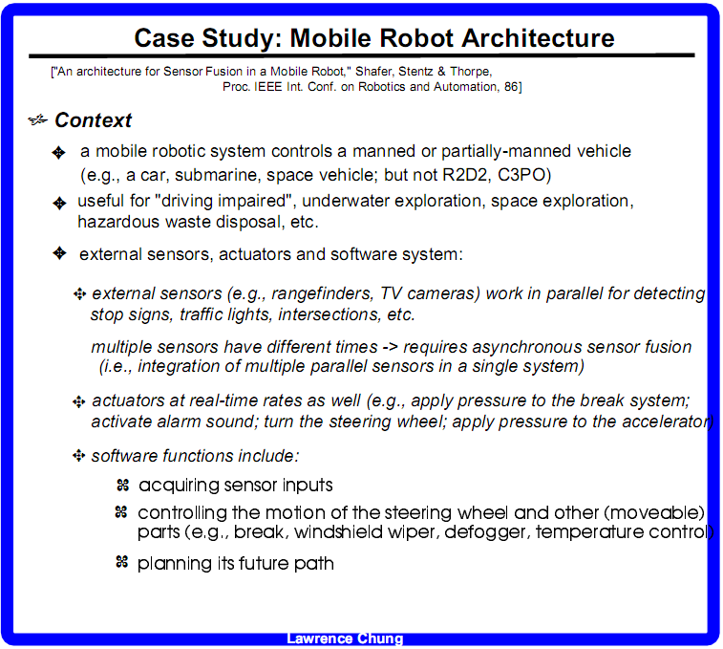

Slide 12
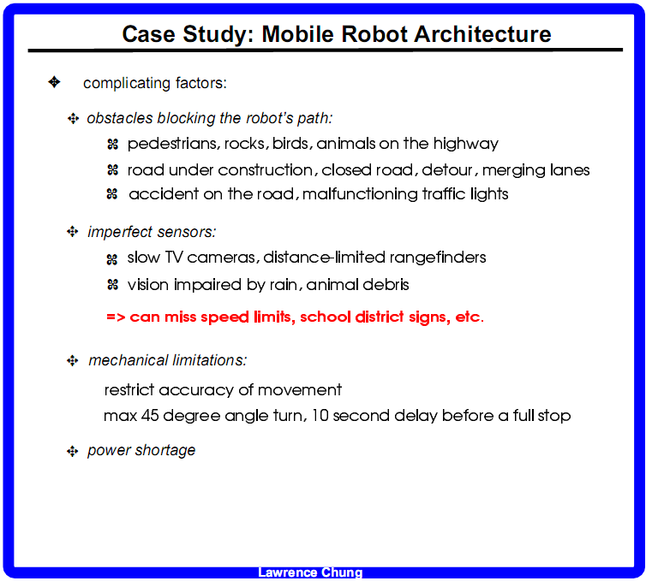

Slide 13
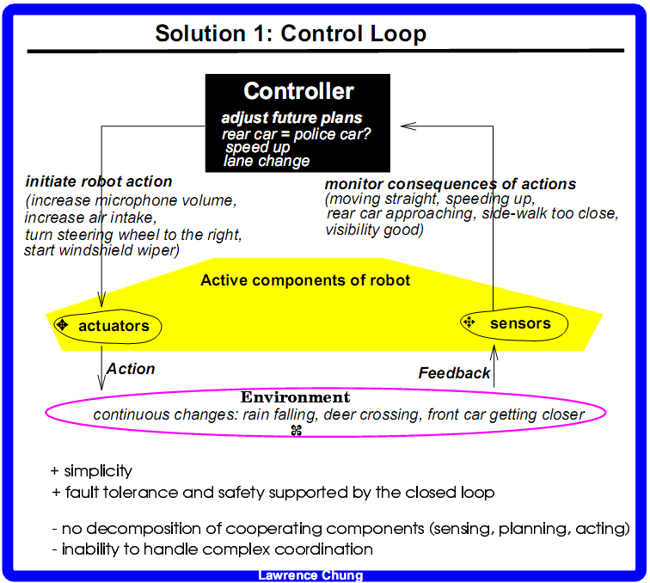

Slide 14
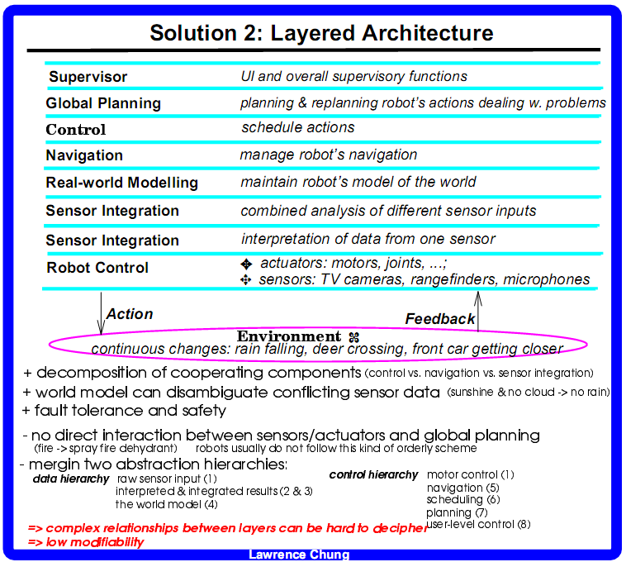

Slide 15
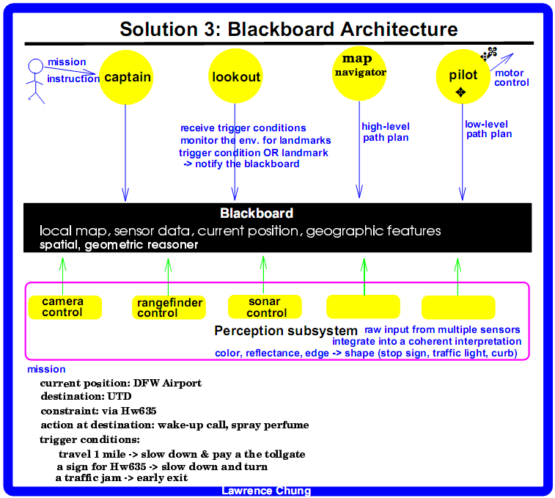

Slide 16
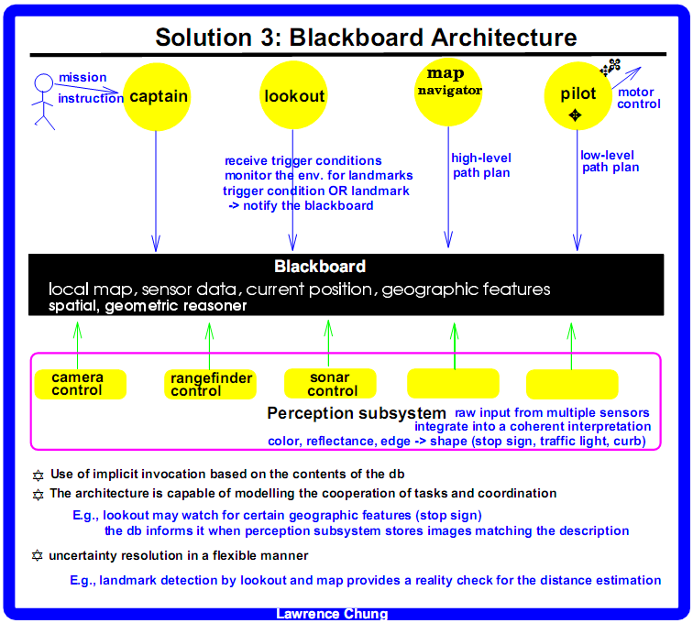

Slide 17
